Slide 1
Winters Education Foundation

Slide 2
Founded in 2009
Offset state funding cuts to Winters JUSD
Provide community support for endangered school programs

Slide 3
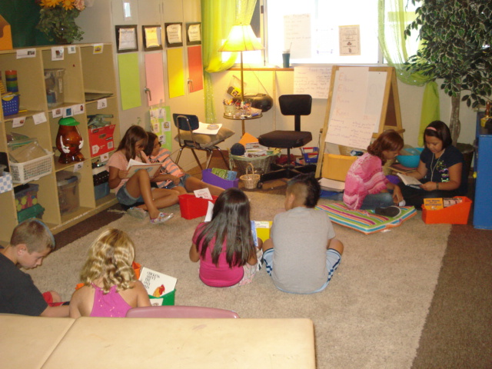
Mission Statement
To raise funds to ensure continued educational excellence and equal educational opportunities for every child in a Winters public school classroom.

Slide 4
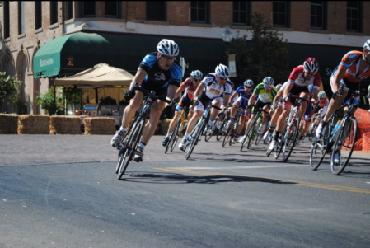
Community Partners
Solano College
Winters PTA
Local Businesses

Slide 5
Financial History

Slide 6
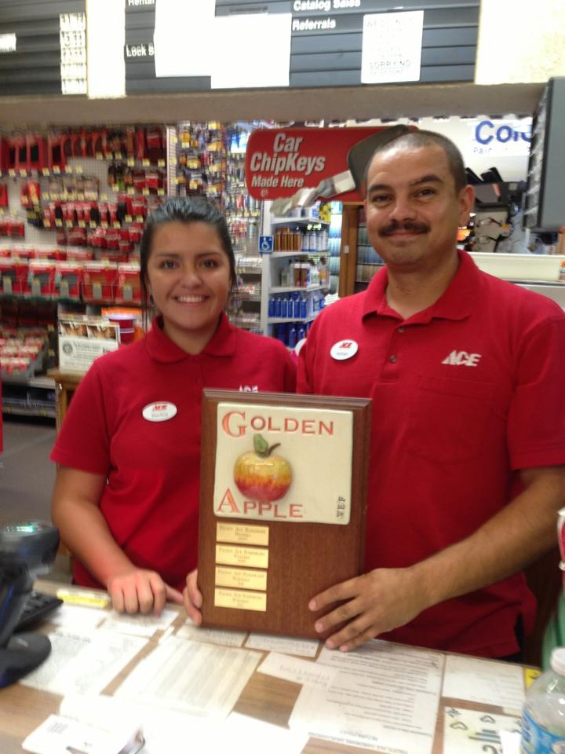
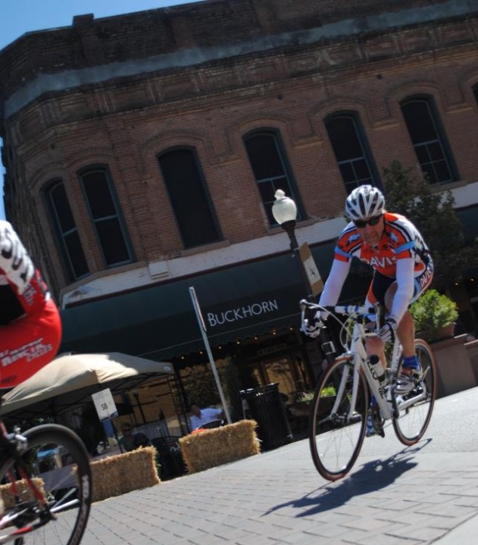
Past Fundraising
Downtown Criterium
Apple-a-Day
Add-a-Dollar
Winters Theater Group
Donations

Slide 7
Winters $ Raised $61,000
Invested to date $52,000
Notes:
The California Department of Education Accountability Progress Report for 2010-2011 combined statistics for Winters Middle and High Schools

Slide 8
Yocha DE HE GRAnt
Conceived by Dr. Fawcett
Grant Application Prepared by WEF
Yielded an Award of 358,780 in 2013
Immediately implemented at HS & MS
$10,500 remains for MS

Slide 9
Accountability
Administrative Costs
Average $511/year
Notes:
The California Department of Education Accountability Progress Report for 2010-2011 combined statistics for Winters Middle and High Schools

Slide 10
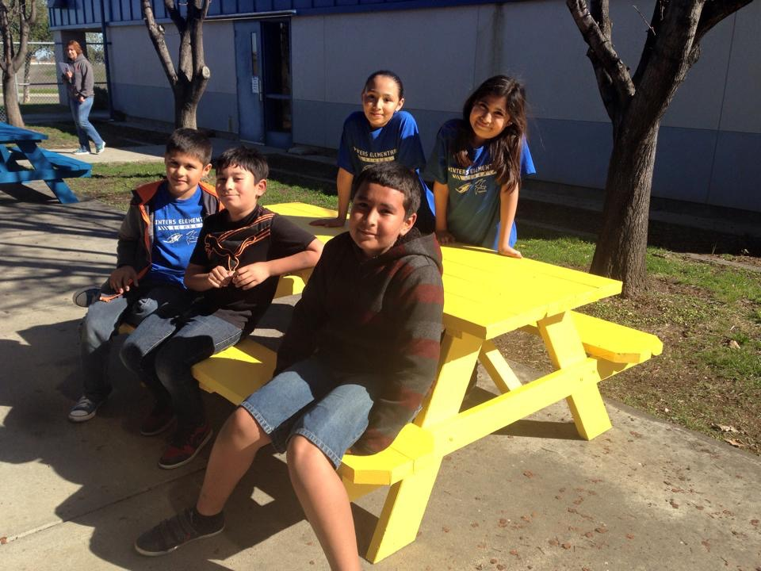
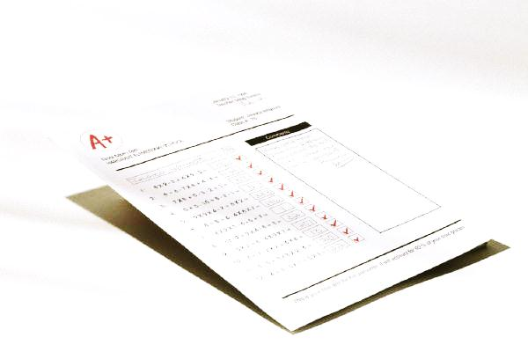
Projects funded
Science materials
Literary Field Trips
PE Equipment
Educational Speakers
Outdoor tables
Projectors/readers
Musical instruments
Targeted Reading Materials
Art and Math Equipment
Notes:
The California Department of Education Accountability Progress Report for 2010-2011 combined statistics for Winters Middle and High Schools

Slide 11
Additional support

Slide 12
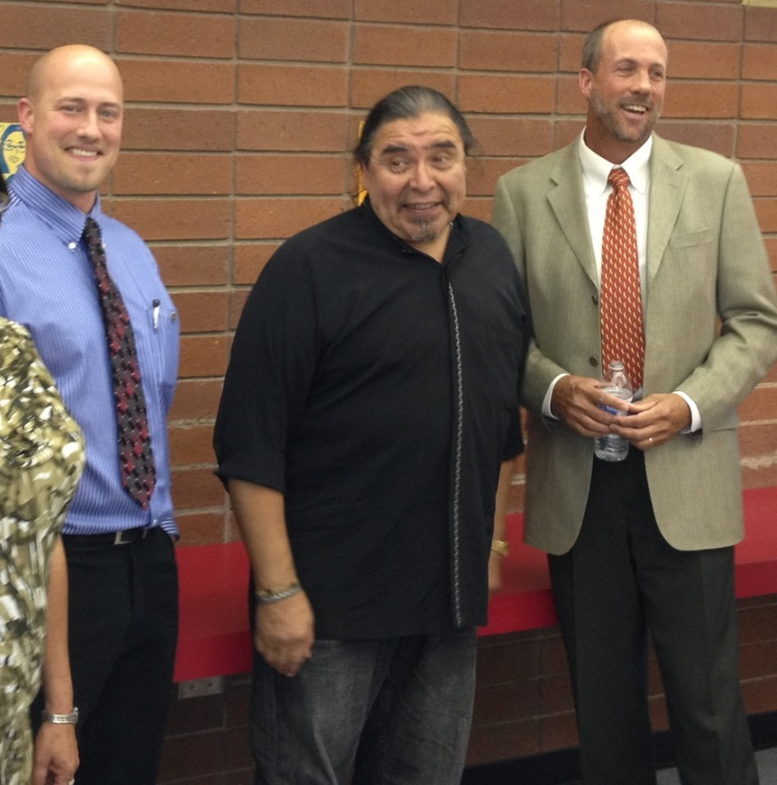
Targeted Grant Writing
HS/MS Technology Grant

Slide 13
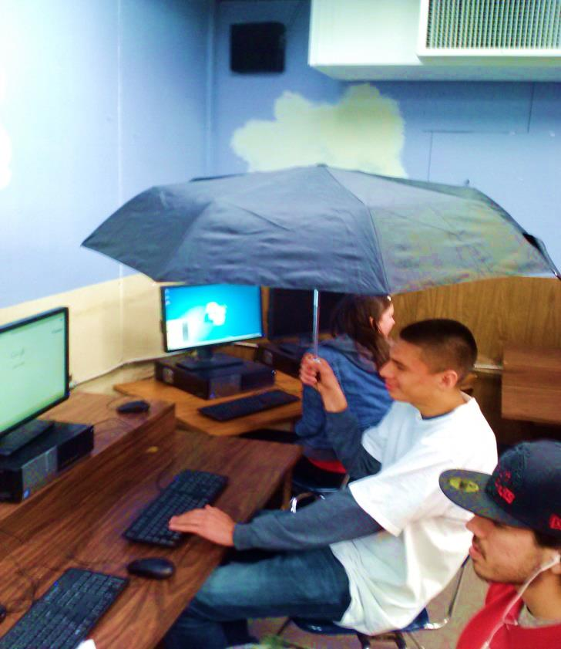
Measure R Leadership
Notes:
The California Department of Education Accountability Progress Report for 2010-2011 combined statistics for Winters Middle and High Schools

Slide 14
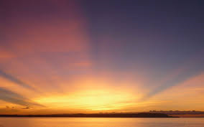
Future for WEF
Social Media Outreach
Building Supporter List
Exploring New Fundraising
Expanding Board and Volunteers
Notes:
The California Department of Education Accountability Progress Report for 2010-2011 combined statistics for Winters Middle and High Schools

Slide 15
Contact US
www.MyWef.org
Facebook
Kurt Balasek
winterseducationfoundation@gmail.com
795-3879 Hm
916 (275)-3024
Notes:
The California Department of Education Accountability Progress Report for 2010-2011 combined statistics for Winters Middle and High Schools

Slide 16
Notes:
The California Department of Education Accountability Progress Report for 2010-2011 combined statistics for Winters Middle and High Schools

